Slide 1
Adaptive Cards in Outlook Sent from PowerShell / Morten Mynster
Notes:
Slide 0: this slide will not automatically turned over. Show this BEFORE the acutal presentation starts.

Slide 2
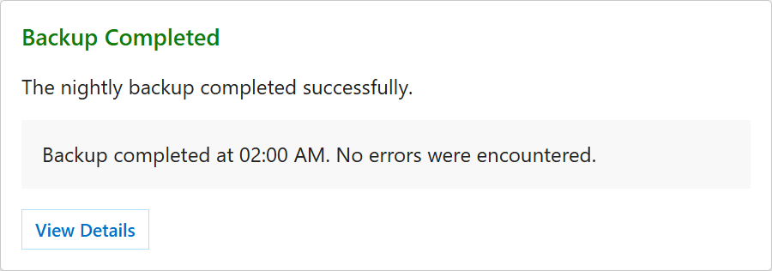
What is an Actionable Message
1 / 20

Slide 3
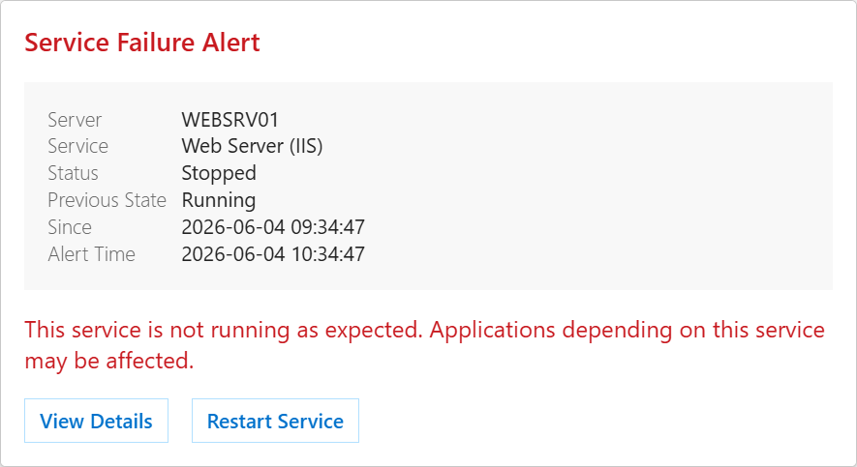
What is an Actionable Message
2 / 20

Slide 4
DEMO

Slide 5
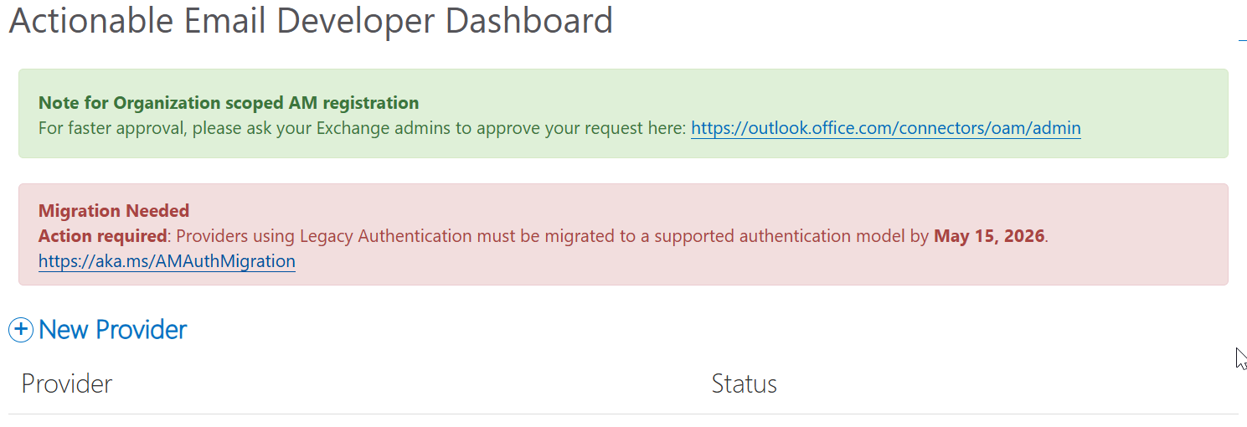
Deprecation

Slide 6
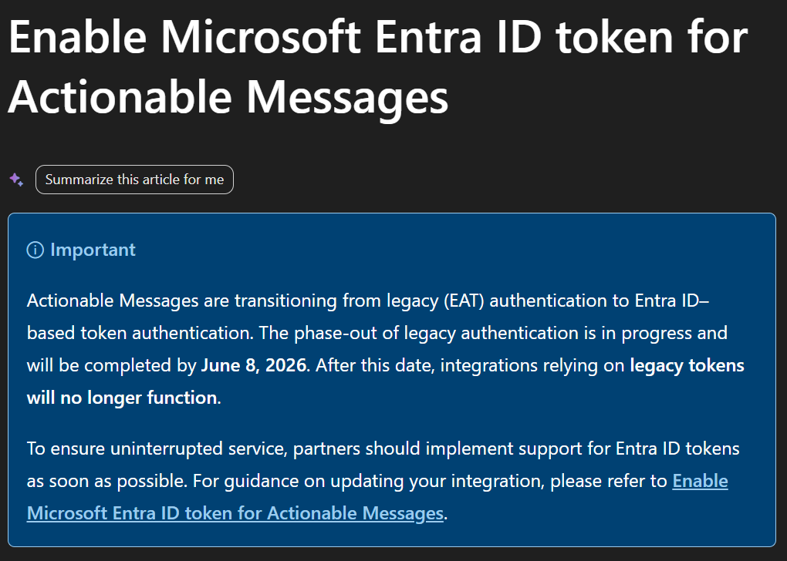
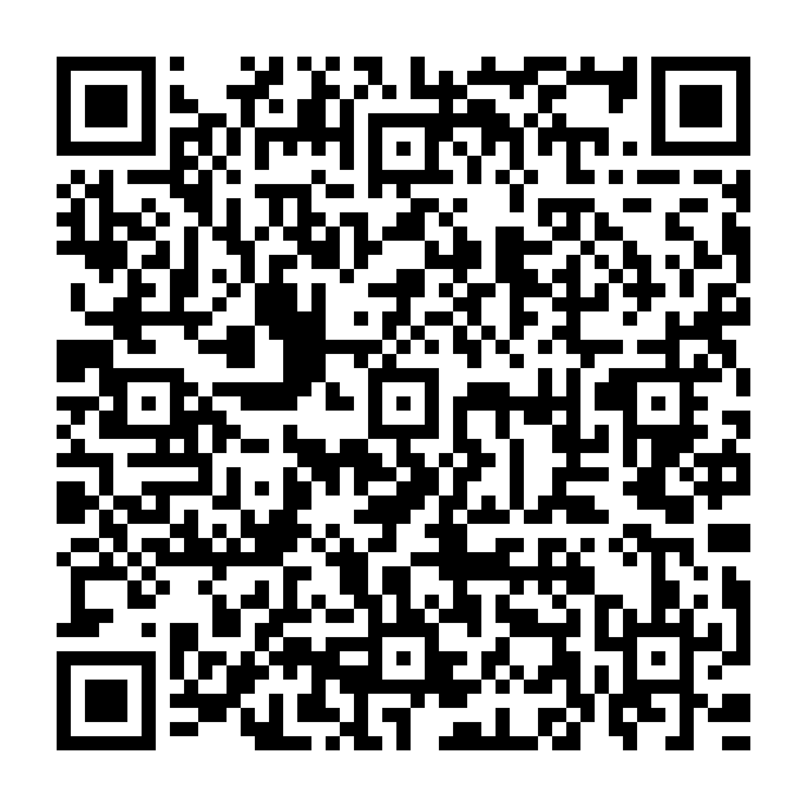
Deprecation old

Slide 7
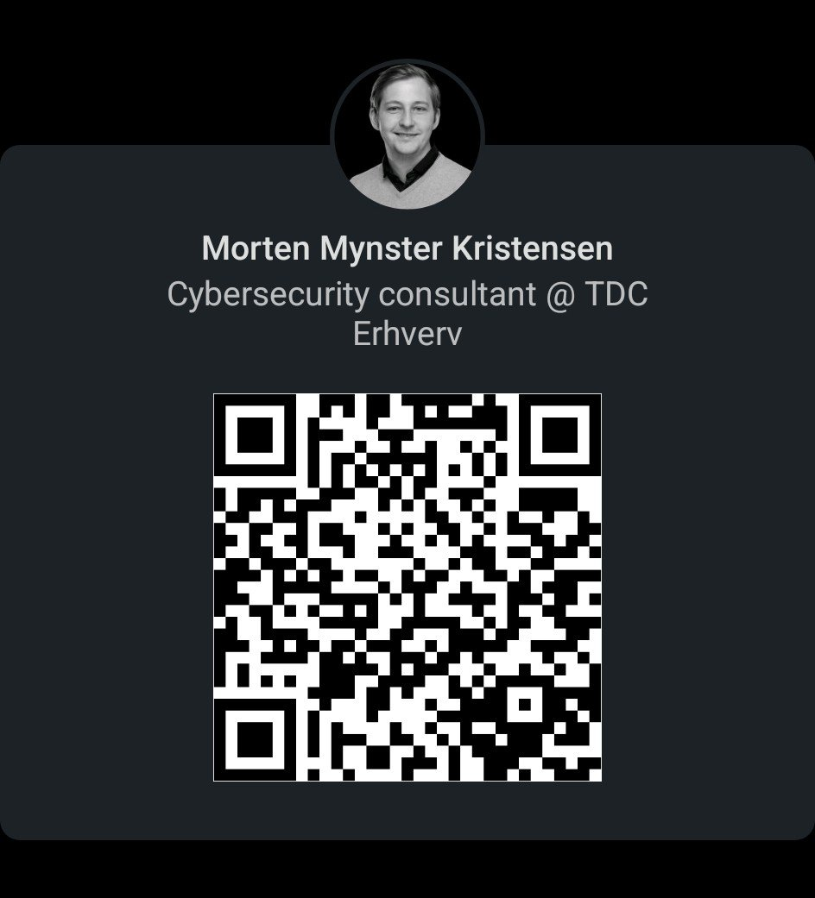
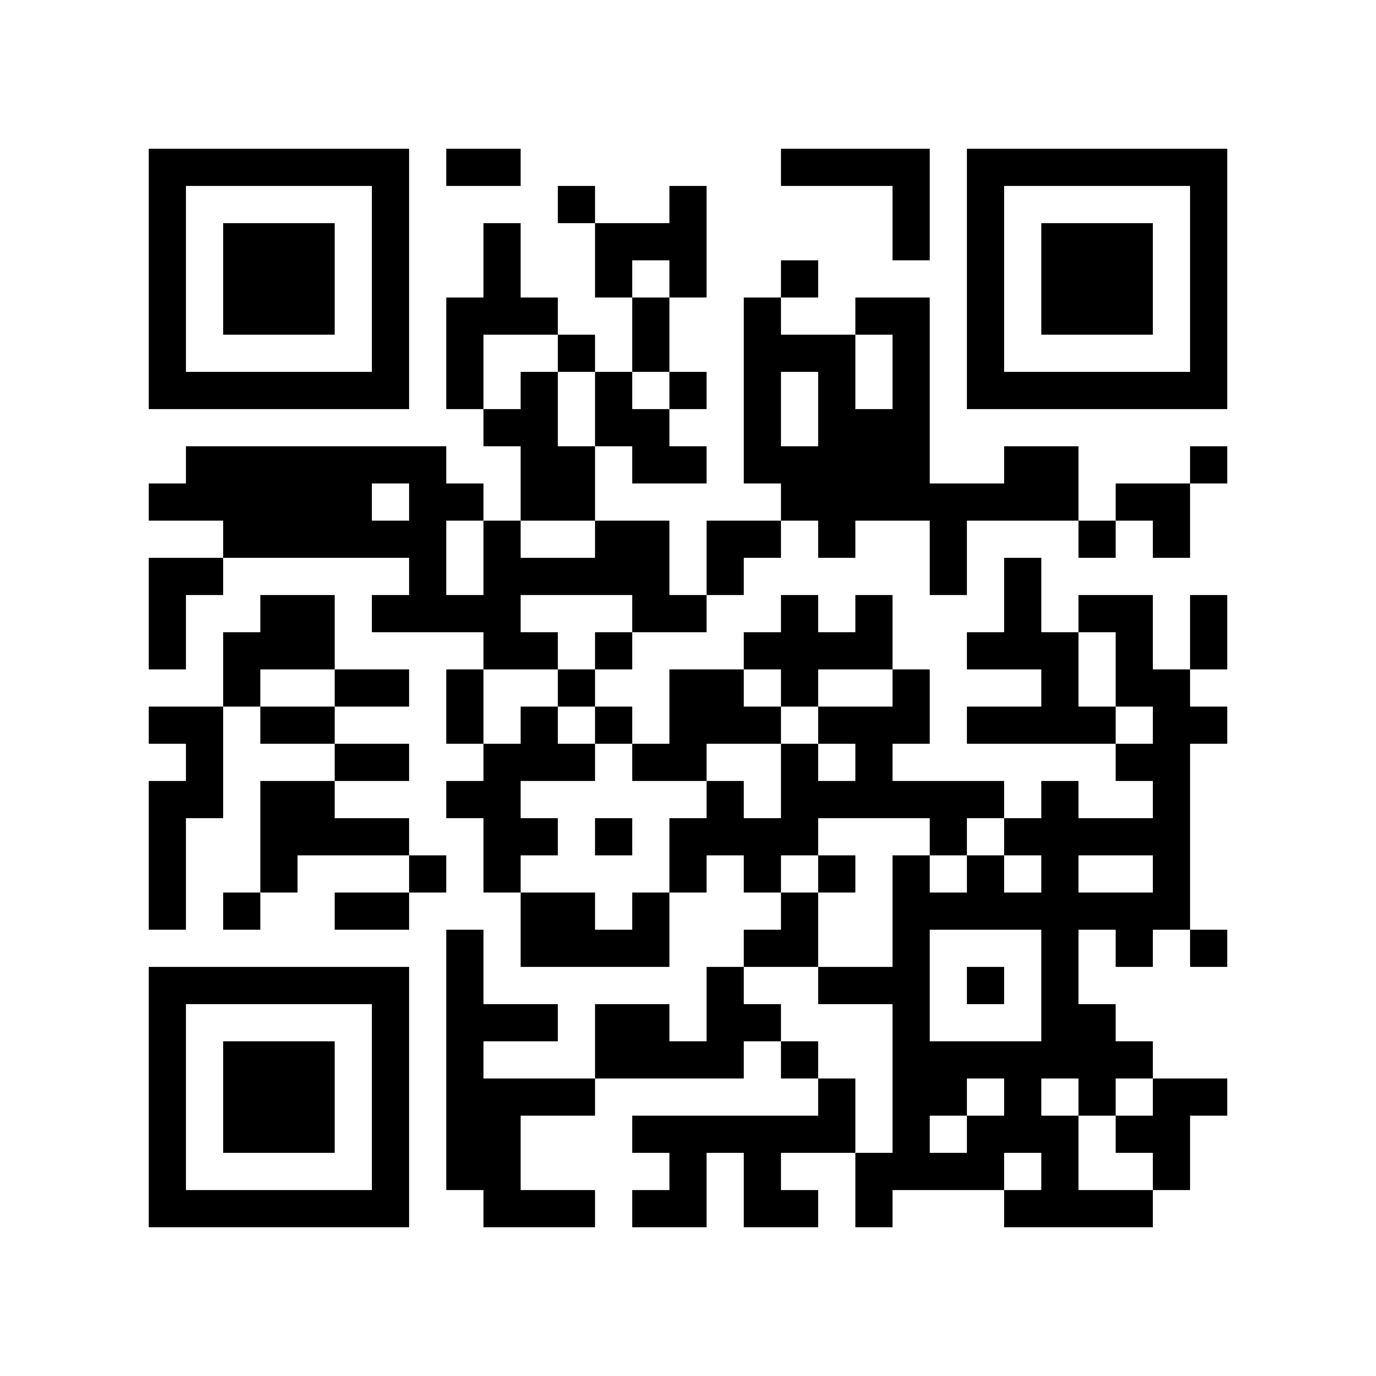
Find me
BLOG:

